Slide 1
Year 11 Raising Achievement Evening
Thursday 14th September

Slide 2
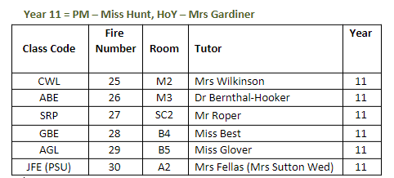
Introduction to the Team
Mr Donovan
Vice Principal Student Progress
Miss Beales
Assistant Principal for Raising Achievement
Mrs Gardiner
Head of Year
Miss Hunt
Pastoral Manager
Mrs Gaines & Mrs Howes
Raising Achievement Mentors
Form Tutors
Mrs Ritchings
Careers and College Support
Mrs Read/Mrs Hillier
SEND

Slide 3
The Year 11 Journey
September 2023
Autumn Term​
Raising Achievement Evening​
BTEC PSAs​
Mock Exams (November)​
Information about next steps (College Application)
Christmas
Spring Term​
Year 11 Parents' Evening ​
BTEC PSAs​
Mock Exams (March)​
College Application completion
Easter
Summer Term
Collapsed curriculum
(Terminal) Exam Period begins
FINAL EXAMS

Slide 4
The Year 11 Journey

Slide 5
BTEC PSAs
September 2023
Autumn Term​
Raising Achievement Evening​
BTEC PSAs​
Mock Exams (November)​
Information about next steps (College Application)
These assessments are set assignments from the exam board.
This means they will be treated like an exam. You must attend them, and expect us to call or request medical evidence if you are absent.
Christmas
Spring Term​
Year 11 Parents' Evening ​
BTEC PSAs​
Mock Exams (March)​
College Application completion
Easter
FINAL EXAMS

Slide 6
Attendance and Our Results
Last Year’s Year 11
Good attendance is above 95%
Year 11 AVG attendance: 83.31
Year 7-11 AVG attendance: 87.77
Of the students who achieved both EN/MA 9-4:
87% of students had attendance 90%+
Of the students who achieved neither EN/MA (9-4):
(68%) students had attendance lower than 90% (more than 40 days off school)
Good attendance is above 95%
Year 7-10 AVG attendance: 86.5
Of the students who achieved both EN/MA 9-4 at the end of Year 10:
The AVG attendance is 96%
Of the students who achieved neither EN/MA (9-4):
The AVG attendance is 86%
EN/MA Grade 4+ is your entry key to college courses (future employment + secure futures)

Slide 7
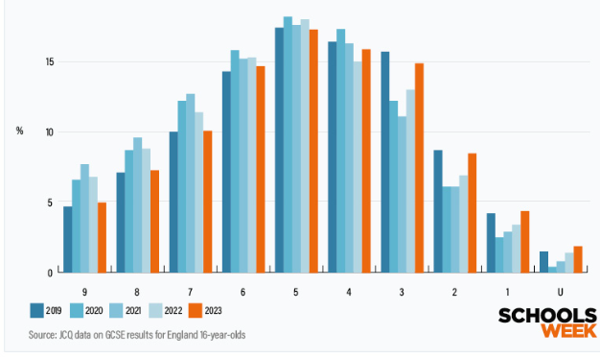
Grade Distribution of GCSEs across England from 2019
Notes:
What we do know from the National picture is 187,000 students failed to achieve the benchmark of a 4 in EN - 41,000 more than last year.
Approximately 184,000 missed this benchmark in MA – 23,500 more than last year.
This has led to 60,000 more students facing resits this year to remain in the next stage of education.

Slide 8
The effort you put in will be worth it!
It is important that when you revise, you are doing something. Just re-reading notes will not be as effective.
Revision techniques may include:
Mind maps
Flashcards
Quizzing
Collective Memory – look, cover, write, check
Using online services like Tassomai and Sparx
Dual Coding – put informtion into words AND visual form
Practice Questions or Question Planning
Videos – as guided by your teachers

Slide 9
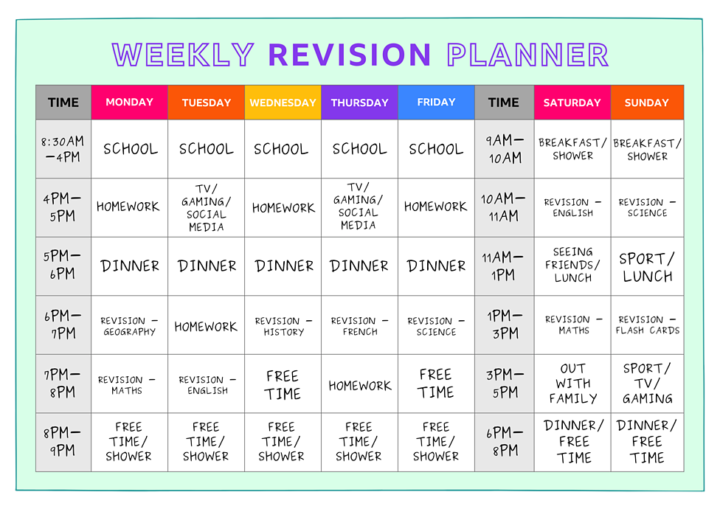
Creating a revision timetable
Speak to us if you need some help creating your timetable.

Slide 10
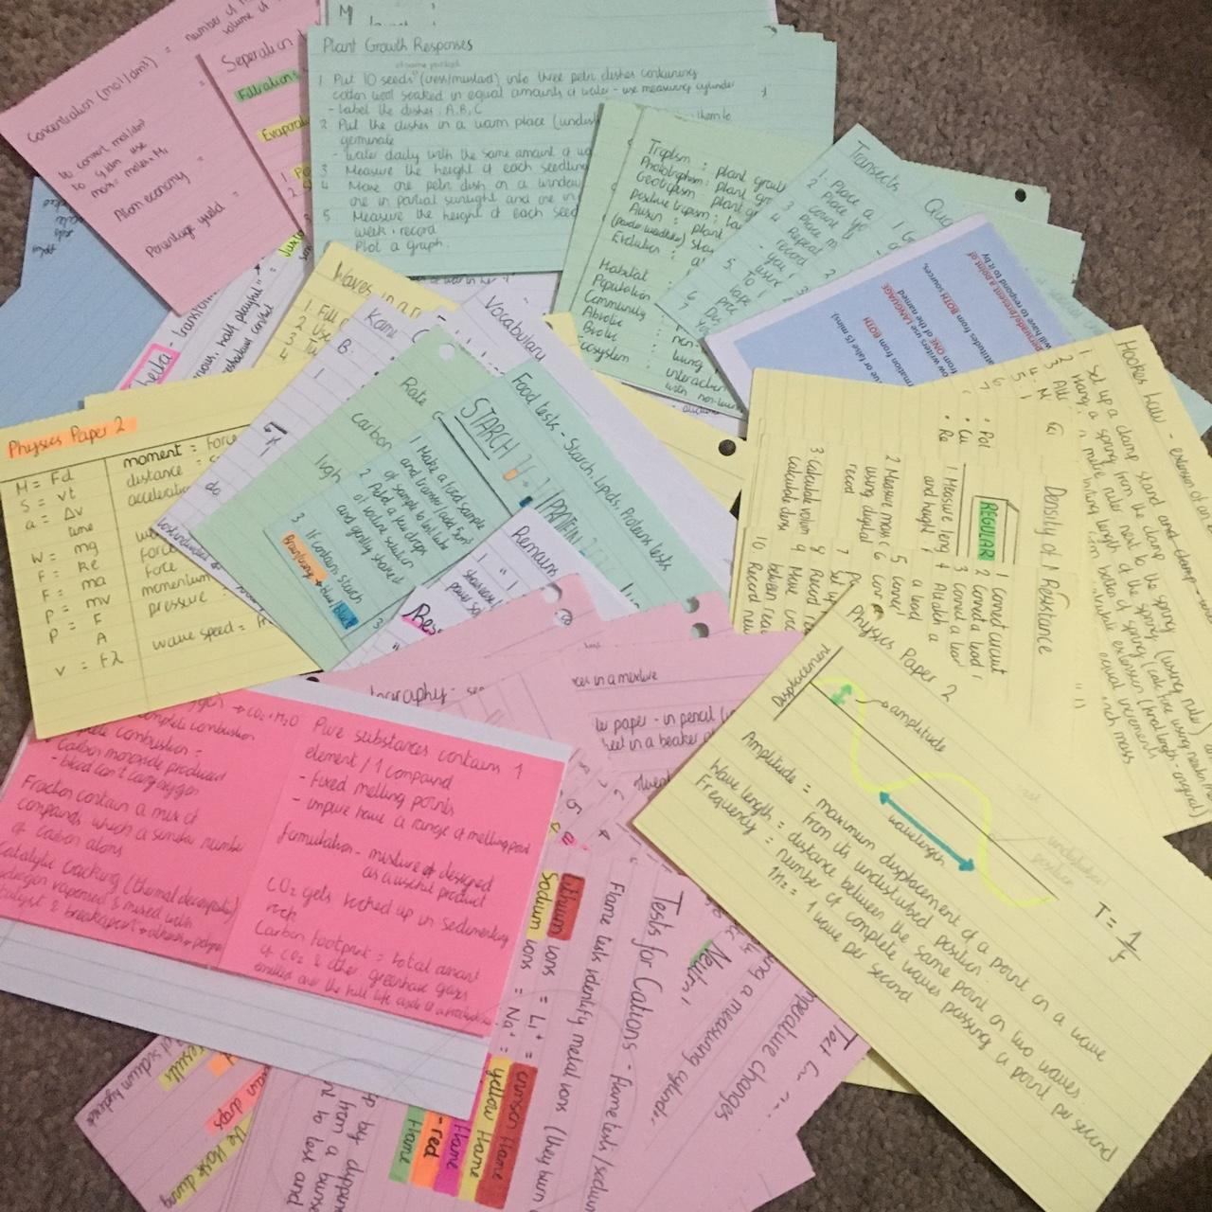
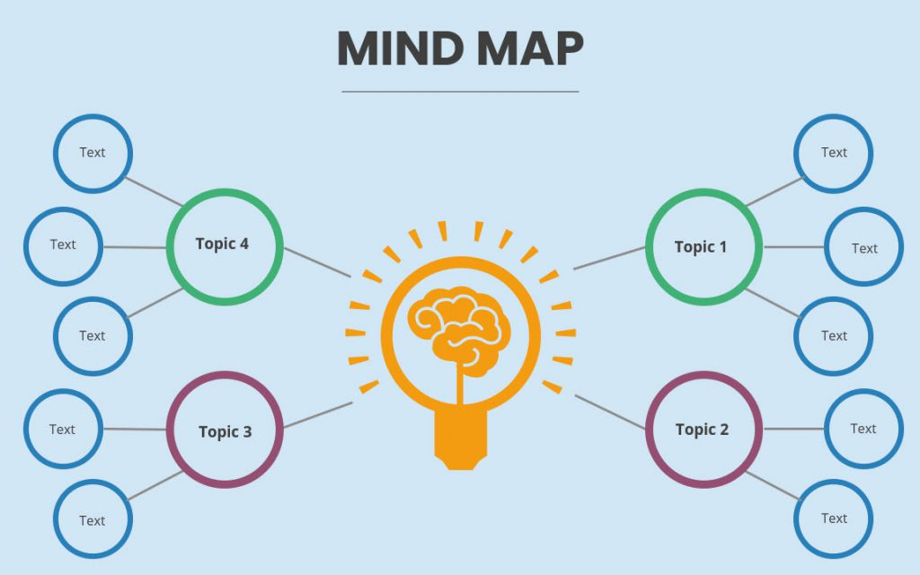
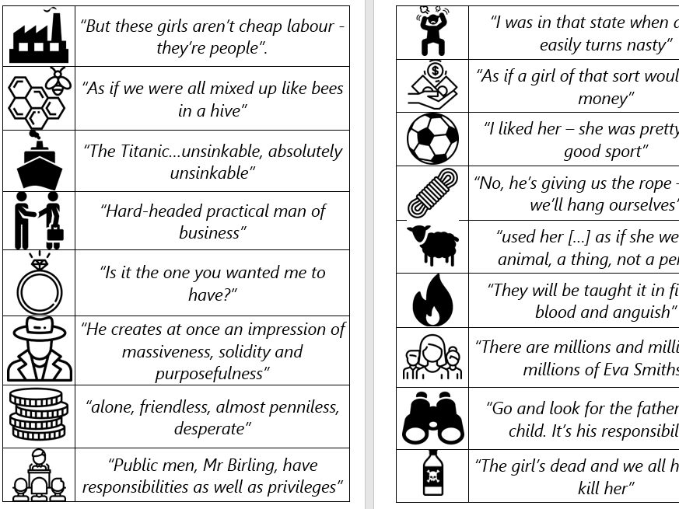
The effort you put in will be worth it!

Slide 11
Top Revision Tips
Create, use and stick to a revision timetable
Complete revision in small chunks
Speak to your teachers – they are the experts in the subject
Reduce distractions – for your short revision chunks, place your phone out of sight & reach
Make sure your revision is specific to what the subject requires you to do/know

Slide 12
Top Revision Tips

Slide 13
English – the GCSEs
English Language
2 x papers
Paper 1-
Reading-analysing and evaluating a fiction text from 20th or 21st century.
Writing- Short narrative or description
(1 hour and 45 minutes, worth 80 marks and 50% of the GCSE)
Paper 2-
Reading- Analysing and comparing two non-fiction text from the 19th and 21st century.
Writing- writing a non-fiction text for example an article of a speech.
(1 hour and 45 minutes, worth 80 marks and 50% of the GCSE)
English Literature
2 x papers
Paper 1-
"Macbeth"- Writing an essay response based on an extract from the play "Macbeth".
"A Christmas Carol" - Writing an essay response based on an extract from the play "A Christmas Carol".
(1 hour and 45 minutes, worth 64 marks and 40% of the GCSE)
Paper 2-
"An Inspector Calls" - Writing an essay response without an extract on "An Inspector Calls"
Poetry Anthology- writing an comparative essay on two poems from the anthology.
Unseen Poetry- Writing an essay response on a poem you have never seen before.
Unseen poetry comparison- Writing a response comparing the unseen poem to one other.
(2 hours and 15 minutes, worth 96 marks and 60% of the GCSE)
Notes:
School offers loads of support – link to attendance/results

Slide 14
English – how to prepare
At School
Put maximum effort into all your lessons.
Complete homework and extended writes to the best of your ability.
Act on feedback from your teacher.
Use your quote explosion booklet.
Attend study hall.
Attend Quote Explosion Club.
At Home
Use online revision tools such as Tassomai
Watch YouTube videos for example Mr Bruff
Create revision resources such as mind maps
Revise quotes- and test yourself!
Read online newspapers such as The Guardian.
Read short stories and novels.
Notes:
School offers loads of support – link to attendance/results

Slide 15
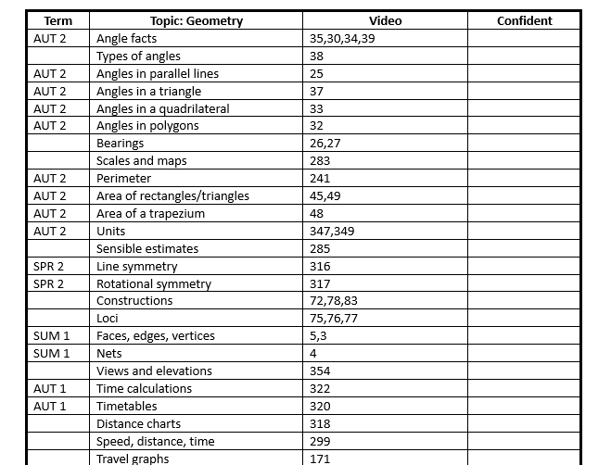
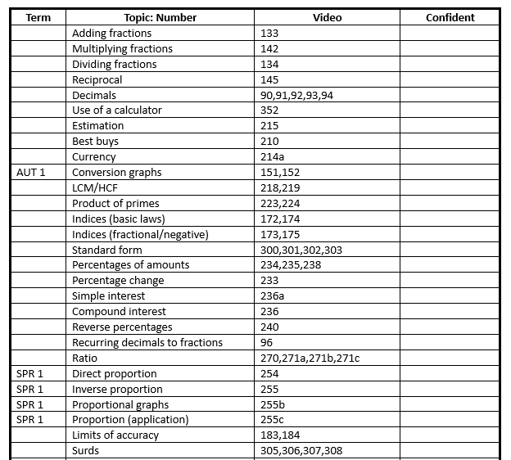
Maths
Everything you need to know!​
Notes:
School offers loads of support – link to attendance/results

Slide 16
Maths
Checklists:
Available for Foundation and Higher tier
Will be given out in Maths classes
States what term topics will be delivered
Video clips are free! Available through corbettmaths.com
Enables students to revise independently at home, alongside their Sparx Maths home learning.
Notes:
School offers loads of support – link to attendance/results

Slide 17
Science
All students are completing AQA combined Science.
Students have a Biology Teacher, Chemistry Teacher and Physics Teacher.
If you are considering getting a Revision guide we suggest the CGP GCSE AQA Combined Science guide.
There is a lot to remember in a Science GCSE, so my best tip for revision is to start now and do little and often.
If invited to intervention we will be offering free small group tutoring please make sure your child attends
Science is about understanding the world around you, and now is the easiest time to learn it!
Notes:
School offers loads of support – link to attendance/results

Slide 18
RAC Support
Raising Achievement/Parents Evenings
Afternoon registration revision programme
Targeted academic mentoring programme
Study Skills session with experienced Year 11 teacher (Form tutors in form)
Academic target setting from AtL
Targeted academic support tailored to individual students
Online revision programme for English, Maths, Science, History and Geography
Core PE intervention programme (some students won’t be doing PE until PSAs are completed EN/MA grades 4+)
In class support and withdraw/catchup sessions
Individual catchup plans
After school intervention programme, both voluntary and targeted
Study Hall support built around English, Maths and Science
Tailored mock exam structure
RAC Breakfast and early morning exam revision
Easter Revision School
College Applications support
Year 7-10 AVG attendance: 86.5
Notes:
School offers loads of support – link to attendance/results

Slide 19
Coming soon...
Core PE intervention programme (some students won’t be doing PE until PSAs are completed EN/MA grades 4+)
Some students will soon be coming out of PE lessons so that they can catch up with BTEC Coursework – e.g. Sport & Health and Social Care.
If you're one of these students, you will always report to PE first to get your mark, before being taken to the catch up session that you are expected at.
Notes:
School offers loads of support – link to attendance/results

Slide 20
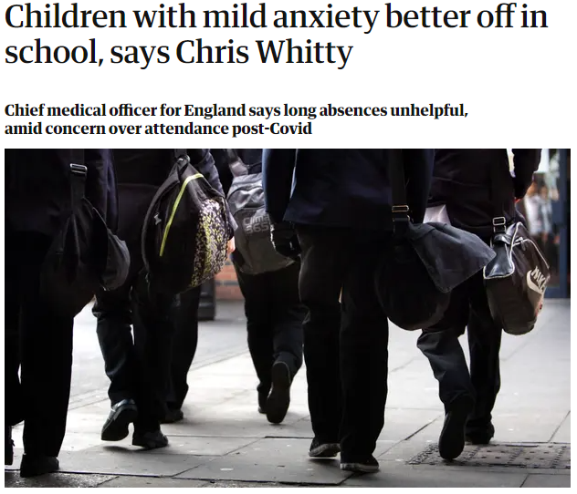
Year 11 can be hard... how will we support you?
Experienced SLT pastoral team
Experienced pastoral team
Experienced form tutors
Pastoral support plans
Strong relationship with your parents/carers
Known systems
Group and individual mentoring
Counselling
Mental Health Support Team
Year 7-10 AVG attendance: 86.5​

Slide 21
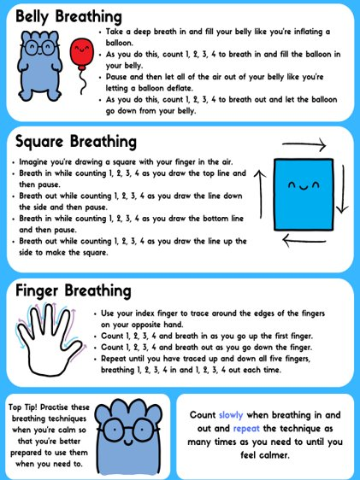
Other support available

Slide 22
Wellbeing Helplines and websites
There are lots of national telephone helplines and websites that can be contacted for support, with many available 24/7. The booklet that accompanies this presentation contains the contact details for many of these.

Slide 23
Revision/Home Learning
Tassomai (English Literature, Science, History and Geography) and Sparx (Maths)
Termly Knowledge organisers
Home learning and revision linked to your subjects
New home learning and revision procedure – including a more rigorous response for those not completing and praise and rewards for those that do.
These can be completed on your phones.
Study Hall will also be available.

Slide 24
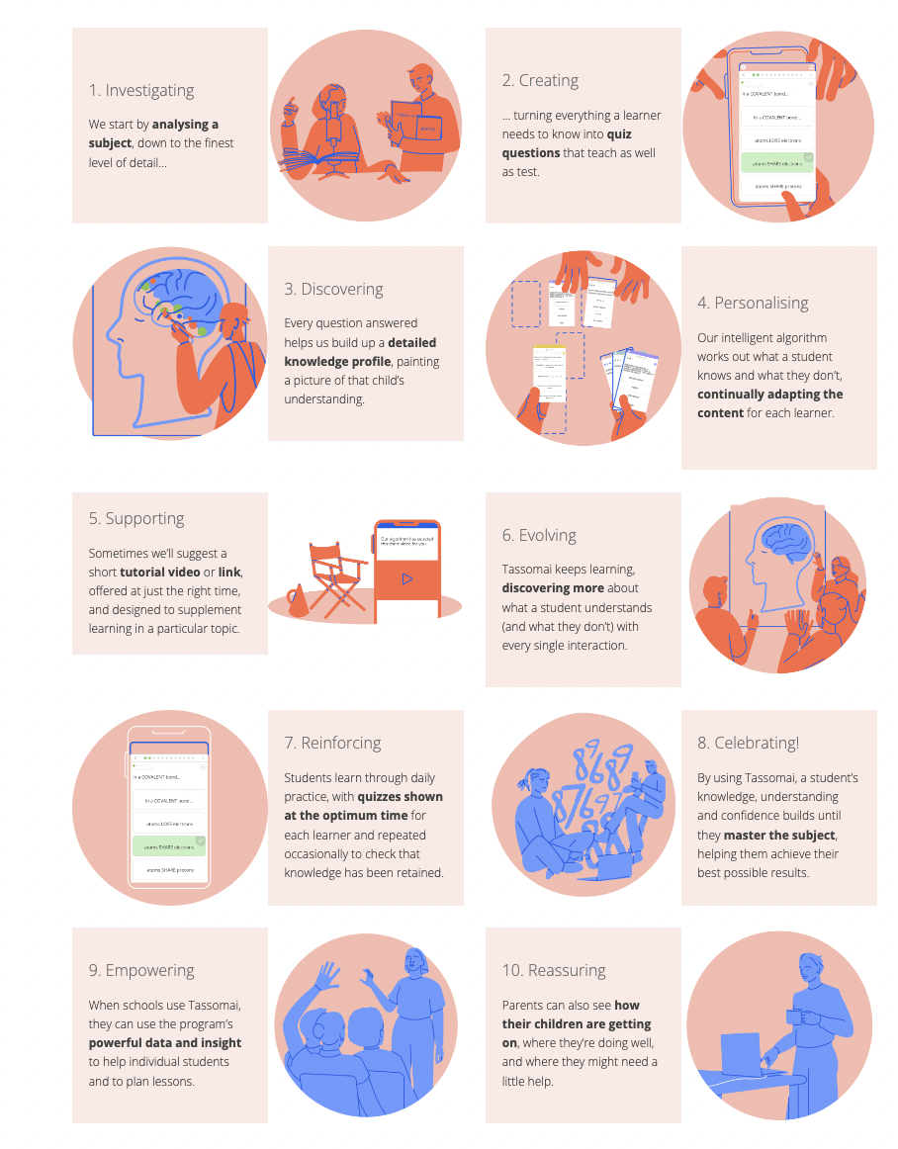
Tassomai
English Literature
Science
History
Geography

Slide 25
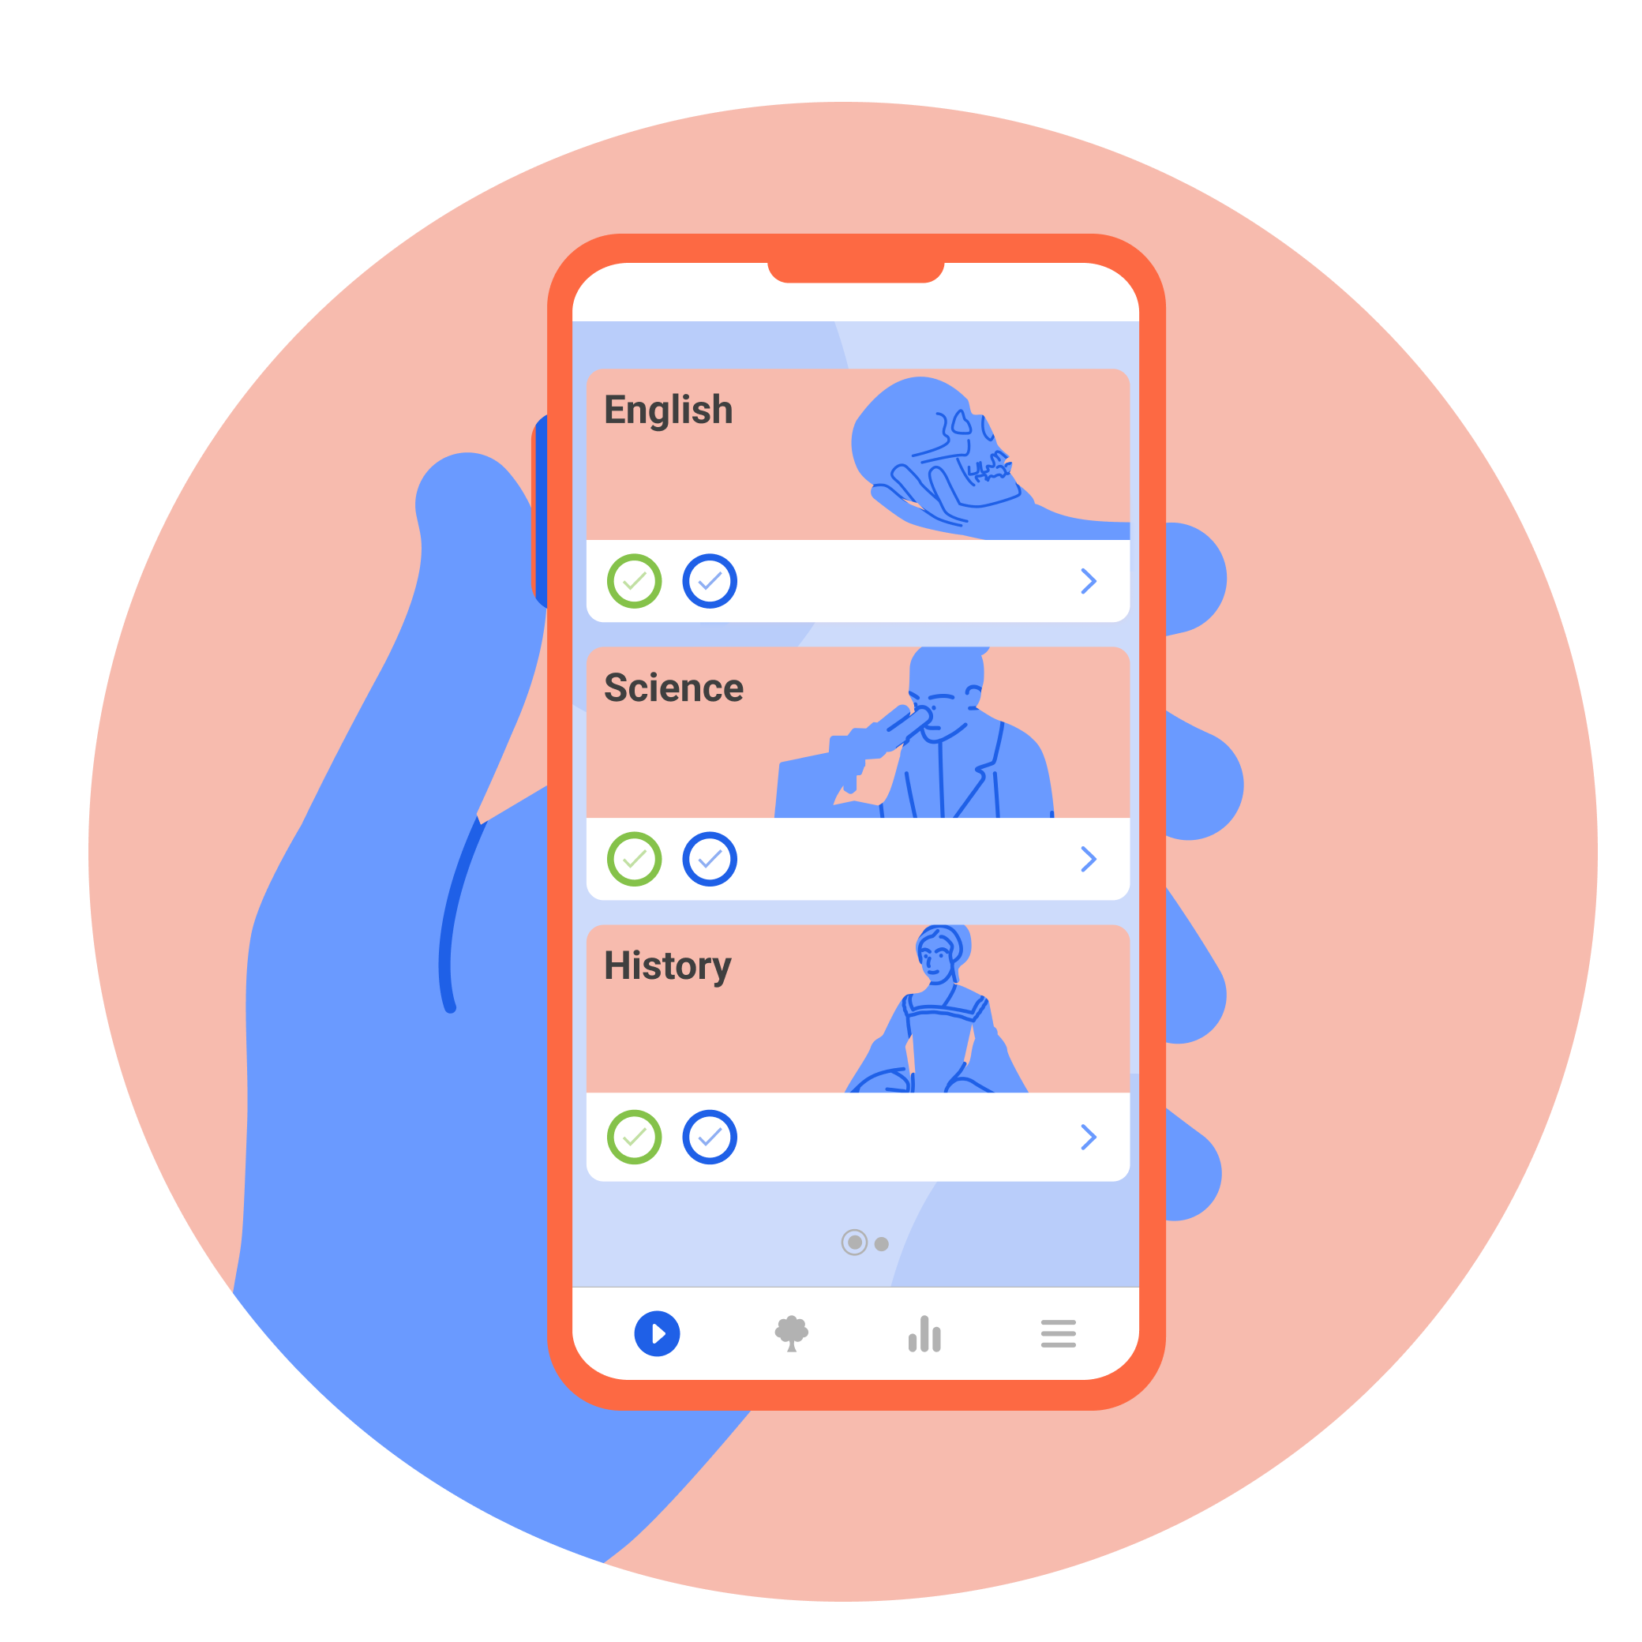
Tassomai
Tassomai is an online learning tool designed to improve students’ accuracy and confidence in English, Science, History and Geography through low-stakes, multiple-choice quizzes.
The adaptive algorithm works hard in the background to select the right content at the right time for you depending upon your current strengths and weaknesses.
Students can use their mobiles phones, tablets or computers to complete the daily learning goals.

Slide 26
How does Tassomai work?
Each day, you will be given a Daily Goal in the subject(s) you're assigned to.
The algorithm will have selected quizzes at the appropriate length and challenge for you, and you have the entire day to complete their DG (Complete in Study Hall or at home).
Correct answers give points towards the DG, but incorrect answers will take points away – so accuracy and working carefully is better than trying to rush!
Tassomai quizzes do NOT have a time limit, so you are
encouraged to take your time, and refer to your
books/notes if you're unsure of the answer.

Slide 27
Is Tassomai just quizzes?
No! There are supportive videos embedded within the system that will play before a quiz on a topic you have been having trouble with. If you watch these videos you can double the amount of points they earn in that quiz!
As an extension - once a Daily Goal has been completed in a subject, you will unlock three online resources to read or watch. The algorithm selects these based upon where they had some trouble during their quizzing. These reset when DGs do – at midnight.
Each subject also comes with a Tassomai Tree – an interactive graphic that grows as you progresses. Branches on the tree are topics within the subject, and leaves are questions in that topic. Green leaves show strong knowledge, while redder leaves highlight areas for improvement.

Slide 28
Tassomai

Slide 29
Tassomai for parents - how can we help?
Once your students are up and running, Tassomai provides a weekly progress report to all parents for each of their children using the platform, sent via email.
We also create a free login for parents, allowing them to login via our mobile app, and monitor their child’s progress.

Slide 30
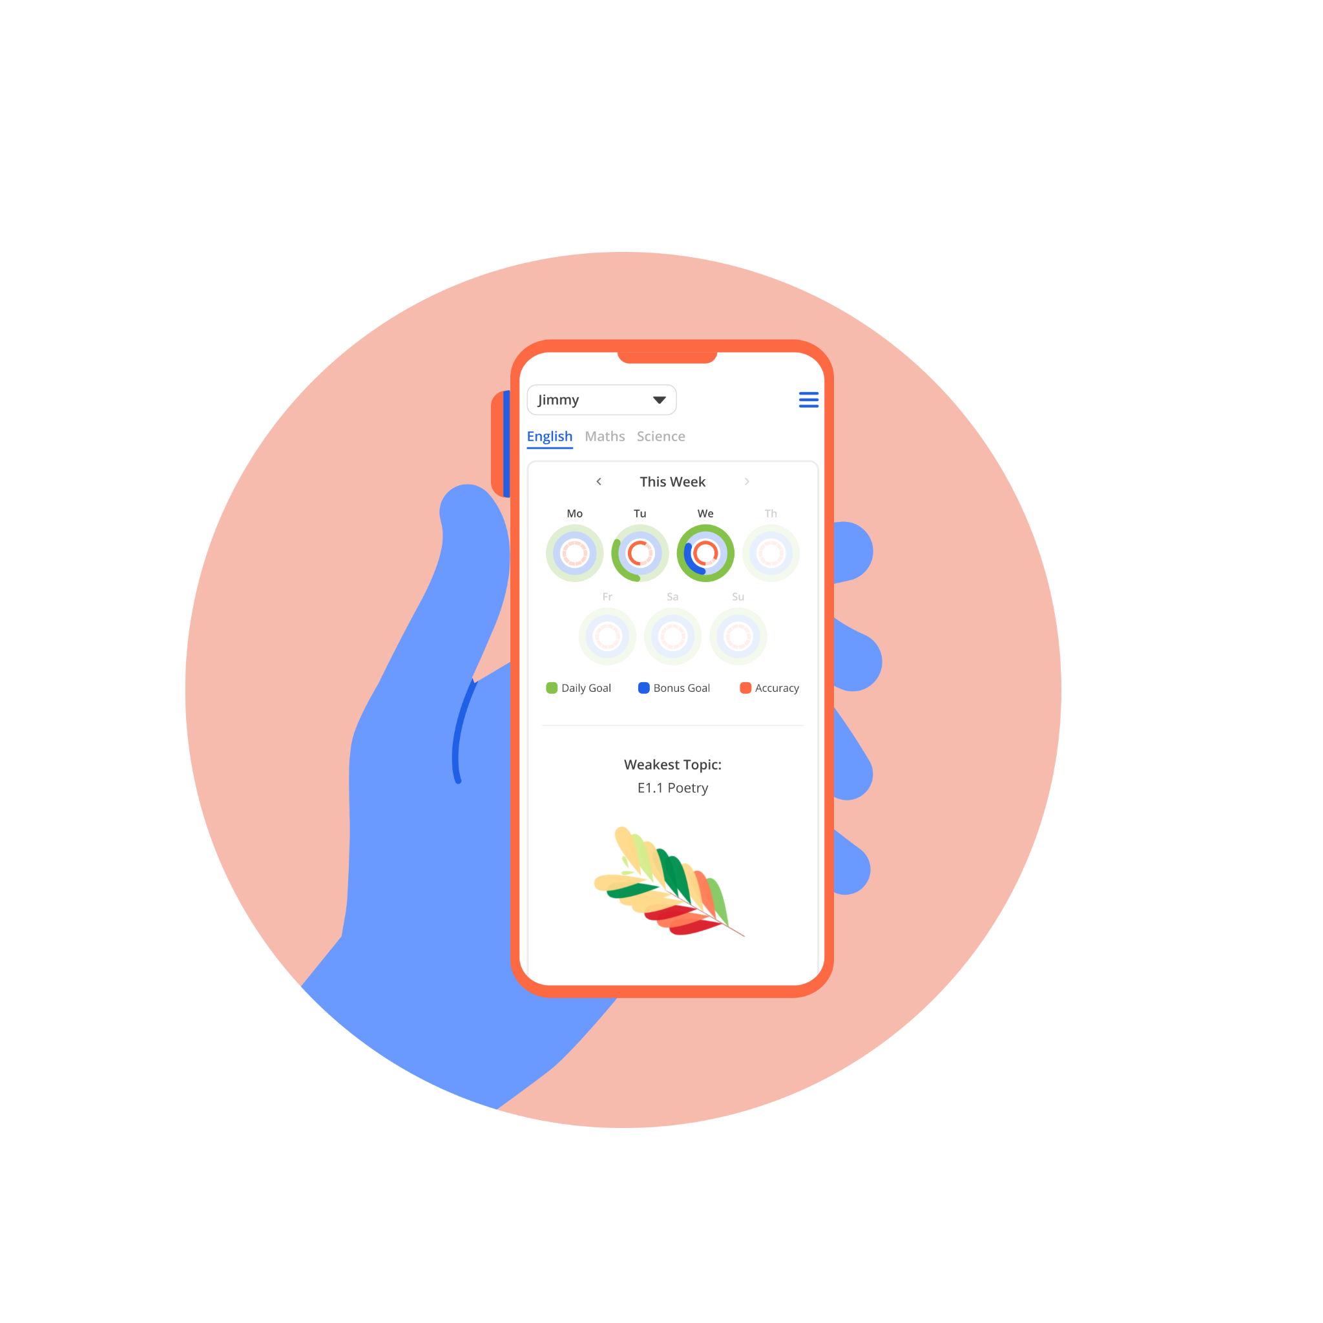
What does the parent dashboard offer?
Parents can monitor their children’s Daily Goal completion across the week (and go back by up to 3 weeks’ worth of activity).
It will also highlight the weakest areas for their child across their subjects, and provide resources to help support learning.

Slide 31
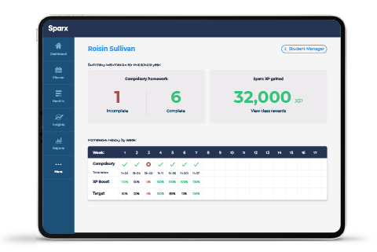
Sparx Maths
Launching 20th September

Slide 32
Exam Preparation
Exam structures in place
External English marking
Year 11 teachers act as examiners
Expert exams officer
Experienced invigilators
An understanding of JCQ rules and regulations

Slide 33
Key Dates
Autumn:
Mock exams – w/b 13th November 2023
Spring:
Mock exams – w/b 26th February 2024
Exam window:
w/b 6th May 2024 – w/b 17th June 2024

Slide 34
Preparing for Mocks
To prepare for the mock exam series we will running the following support sessions/activities:
Booster session: on the day before any actual exam (not mock exam), students will work with their subject teacher refining their knowledge and skills and completing final revision activities ready for the next day.
Raising Achievement (RA) Pre-Exam revision breakfast for all morning exams: we expect students to arrive for 8:00am. The RA team will sign the students in and provide snacks and hot drinks. The subject teams are also on hand with revision resources and guidance. It is important that students get in the habit of getting to school earlier to have breakfast and to settle their nerves. This way when they sit their actual GCSEs they are familiar with the routine which in turn, ensures a calmer start to their day.
Pre Exam warm up session: from 8:35am to 9:00am, students will move into a classroom with their class teacher to complete their final preparations for the morning exam and answer any final questions about the processes or knowledge required. Where actual exams are being taken in the afternoon, these sessions also include an early lunch to ensure students have a settled lead up to the exams.

Slide 35
Rewards Available
Reward Points up to Christmas
Passport to Prom from Christmas
Ongoing weekly form rewards
AtL improvement rewards
End of half term Film/Pizza afternoons
End of Year celebrations

Slide 36
Prom and Leavers’ Assembly
You need to earn your tickets and place at these celebration events.
This is achieved by the amount of points you earn through completing revision and participating in revision session.
You are at risk of not being invited if:
Your negative points are high
You are frequent visitor to the RR
In these cases, you may be offered contract to improve if you have shown a period time without issue.
If your attendance to school is not above 90% - we will take into consideration medical issue and some other non-attendance to school if special circumstances.
Attendance to events like Raising Achievement Evening, Parents’ Evening and Easter Revision School.

Slide 37
Home Learning and Study Hall
When setting homework or revision your teachers must make clear it links to the learning. It is important that you understanding why/how the task is vital if you are going to be successful and complete the work.
It takes time to build good study habits via homework and revision and it is our job to support you to develop these skills, as we do through our study skills sessions during form time.
When setting homework/revision, teacher will:
Expect you to clearly recorded homework or revision in your planner with clear deadline.
They should check you have done this, at the end of the lesson or at the door at the end of the lesson and make sure you have any resources required.
It is their role to make sure:
You are clear about the homework or revision;
That you understand it and it is something you can do without teacher support;
Make sure it is relevant to an upcoming lesson:
Either revision of previous important knowledge (from the knowledge organiser);
Or revision of concept to be tested in a Do Now.

Slide 38
Home Learning and Study Hall
Q. What happen if I do my homework or revision?
If you complete your homework and revision you will be given reward points and your AtL judgement for home learning will increase moving you up the ranking and leading to further rewards and praise.
Q. What happen if I do not do my homework or revision?
Stage 1. Your teacher will ask the reason for non-completion, offer support and - set an extended deadline. They will also remind you to take responsibility and use the study hall in the afternoon for support.
Stage 2. If you still do not complete the home homework or revision, your teacher will book you into study hall (via Go4Schools – you will also receive a negative point) to work with the Raising Achievements mentors to complete it.
Stage 3. If you do not take responsibility and fail to attend study hall:
You teacher will call your parents and raise the issue with the Head of Department to decide what further support is required.
If you frequently do not complete your homework or revision, you will be placed on subject report to Head of Department and your parents will be invited to the academy for a meeting with your teacher and the Head of the Department.
Stage 4. After the report is complete, if you are still failing to complete homework or revision, your HoY will then be involved and place you on a report

Slide 39
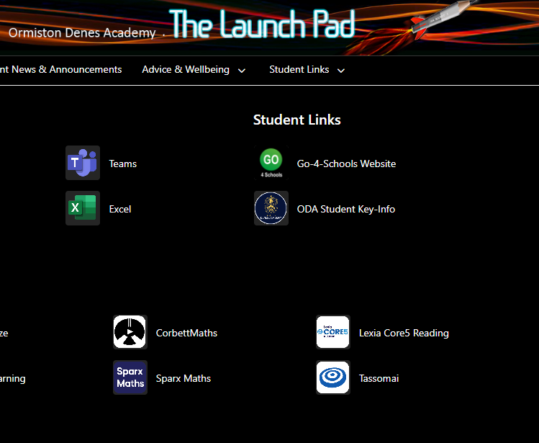
Home Learning and Study Hall
Q. Where is study hall and how does it work?
KS4 Study Hall is in the Entrance Hall and will be run by Mrs Gaines
KS3 Study Hall is in the New Hall and will be run by Mrs Howes.
They have laptops for students who need support for the Maths homework/revision (Sparx) and English, Science, Geography and History Online revision (Tassomai).

Slide 40
Going to College
Year 11 students will have assemblies from various Colleges and Higher Education establishments over the coming months. However, it is really important to also attend College open events.
These are a great chance for future students, parents and carers to get a feel for college life, see all facilities a college has to offer, meet staff and current students, find out about the various courses available, and ask any questions you may have.

Slide 41
College Open Events
You will need to book a place online

Slide 42
College Open Events
You will need to book a place online

Slide 43
College Open Events
You will need to book a place online

Slide 44
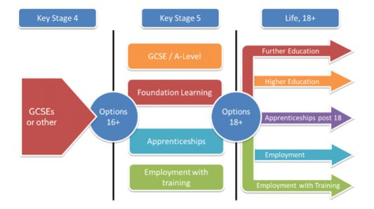
College Open Events
Lowestoft 6th Form College, East Coast College and East Norfolk 6th Form College are in attendance in our Entrance Hall tonight.​
Please take the opportunity to speak to them to find out more about your post 16 pathways​

Slide 45
Careers Support
The academy careers stand in the entrance hall will also have supportive information for students, as well as useful documents for parents.
Speak to Mrs Richings at the careers stand for more information.

Slide 46
Other local Colleges
College websites will show open event details and Year 11 will be emailed with the information as we become aware of any future events.
The careers section of our website will also have details of College open events.

Slide 47
What can I do to support my student?
Ensure your students are in school – attendance is proven to have an impact on results, and this is the way they'll access the expertise they need
Encourage students to continue with their learning from home, e.g. Sparx and Tassomai
Quiz students on their revision
Support students in creating a revision timetable to help manage their time
Receive weekly emails from Sparx/Tassomai to help track their progress
Visit the staff in the entrance hall tonight for more advice

Slide 48
Any questions?

