Slide 1
Tassomai – English
Thursday 14th September

Slide 2
The Year 11 Journey
September 2023
Autumn Term​
Raising Achievement Evening​
BTEC PSAs​
Mock Exams (November)​
Information about next steps (College Application)
Christmas
Spring Term​
Year 11 Parents' Evening ​
BTEC PSAs​
Mock Exams (March)​
College Application completion
Easter
Summer Term
Collapsed curriculum
(Terminal) Exam Period begins
FINAL EXAMS

Slide 3
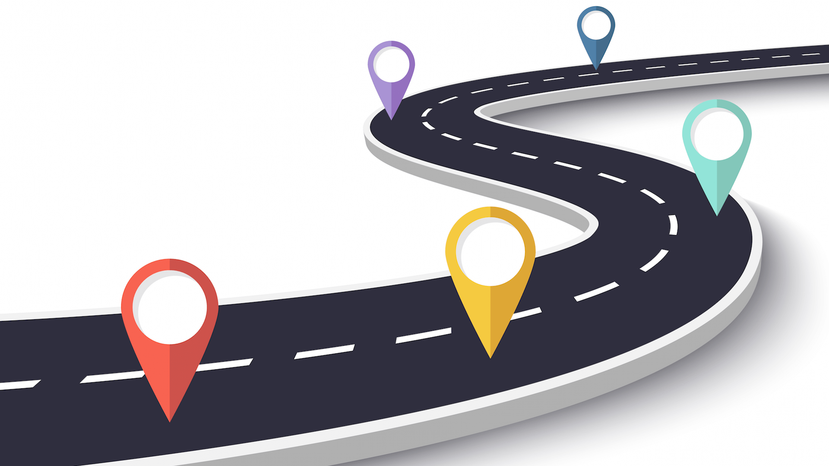
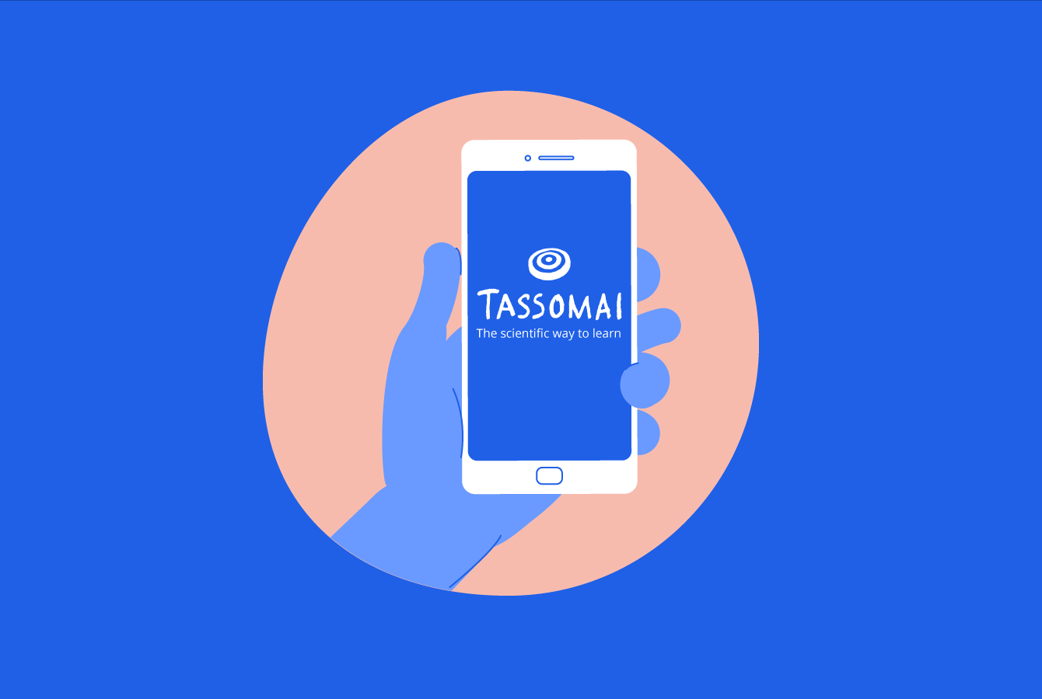
The Year 11 Journey

Slide 4
Revision/Home Learning
Tassomai (English Literature, Science, History and Geography) and Sparx (Maths)
Termly Knowledge organisers
Home learning and revision linked to your subjects
New home learning and revision procedure – including a more rigorous response for those not completing and praise and rewards for those that do.
These can be completed on your phones.
Study Hall will also be available.

Slide 5
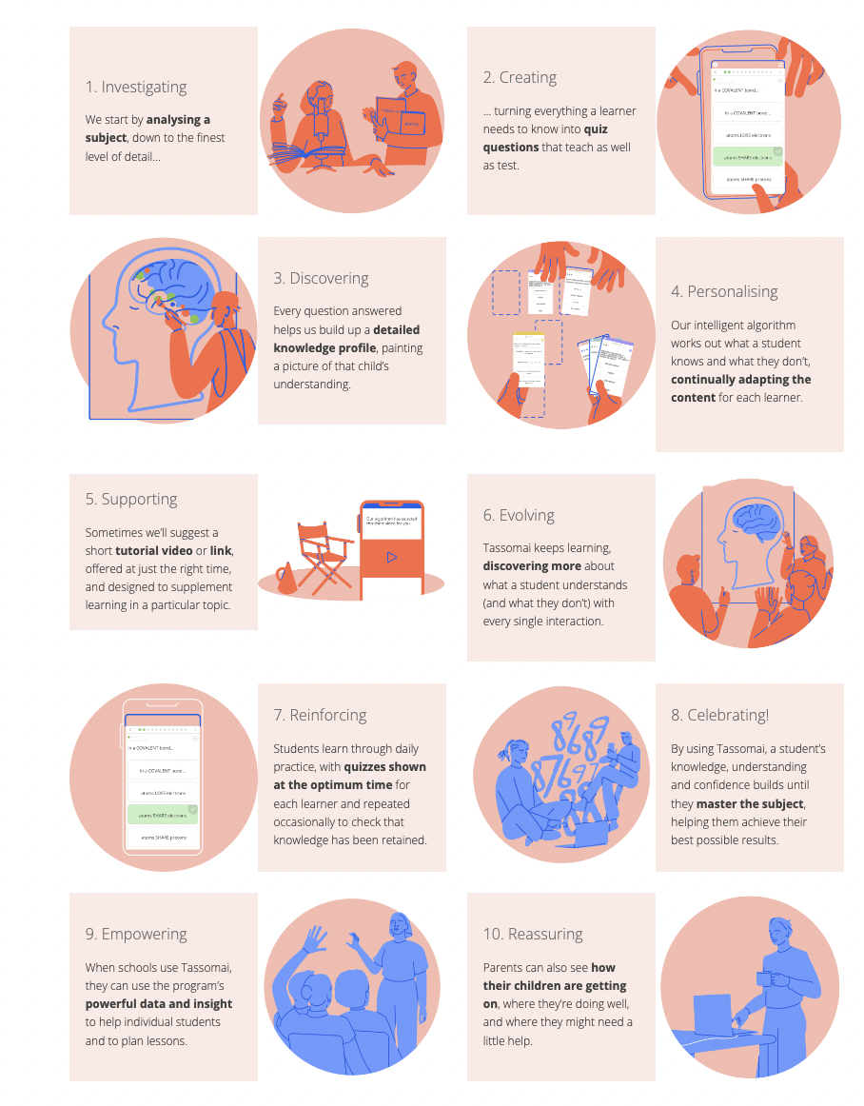
Tassomai
https://www.youtube.com/watch?v=22y75OsLJU8
English Literature
Science
History
Geography

Slide 6
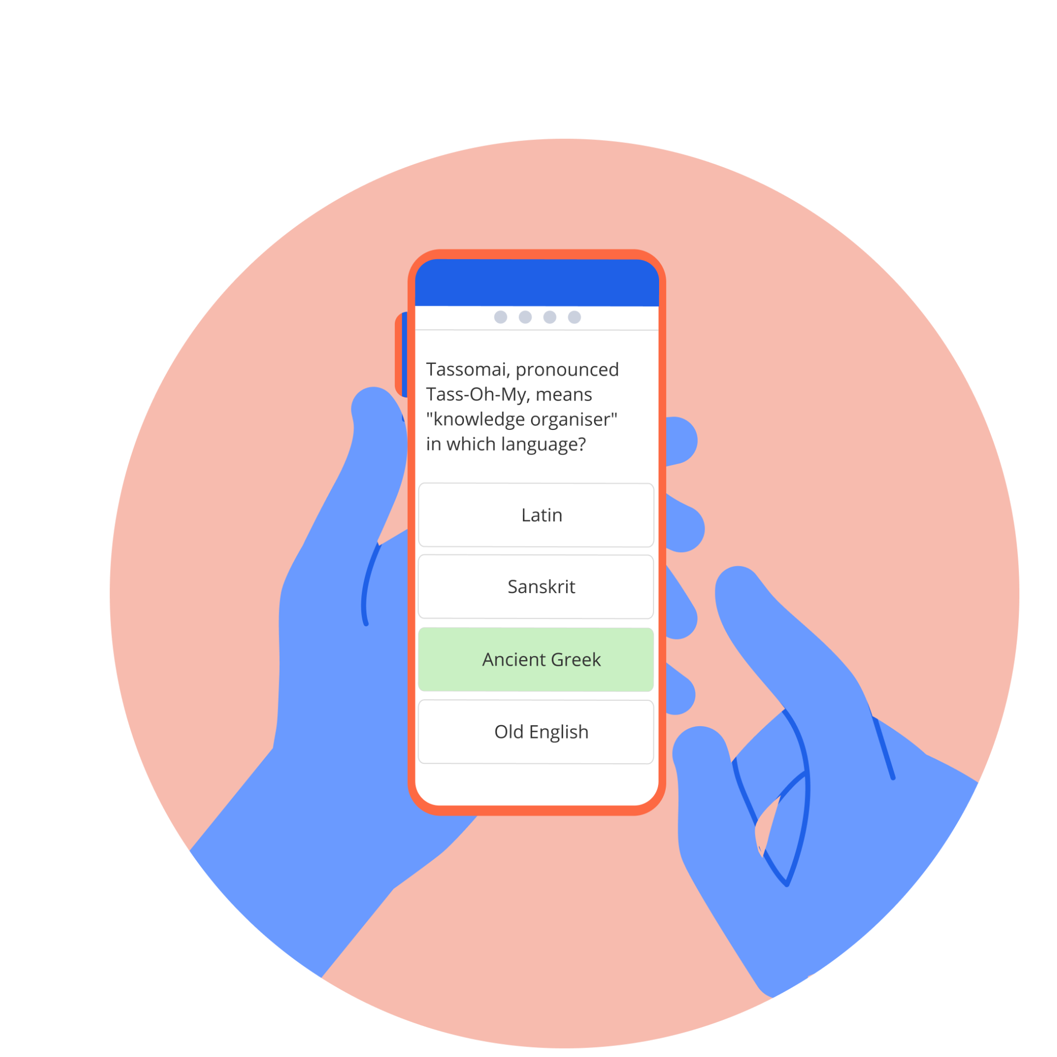
Welcome to Tassomai!
Let’s get you started…

Slide 7
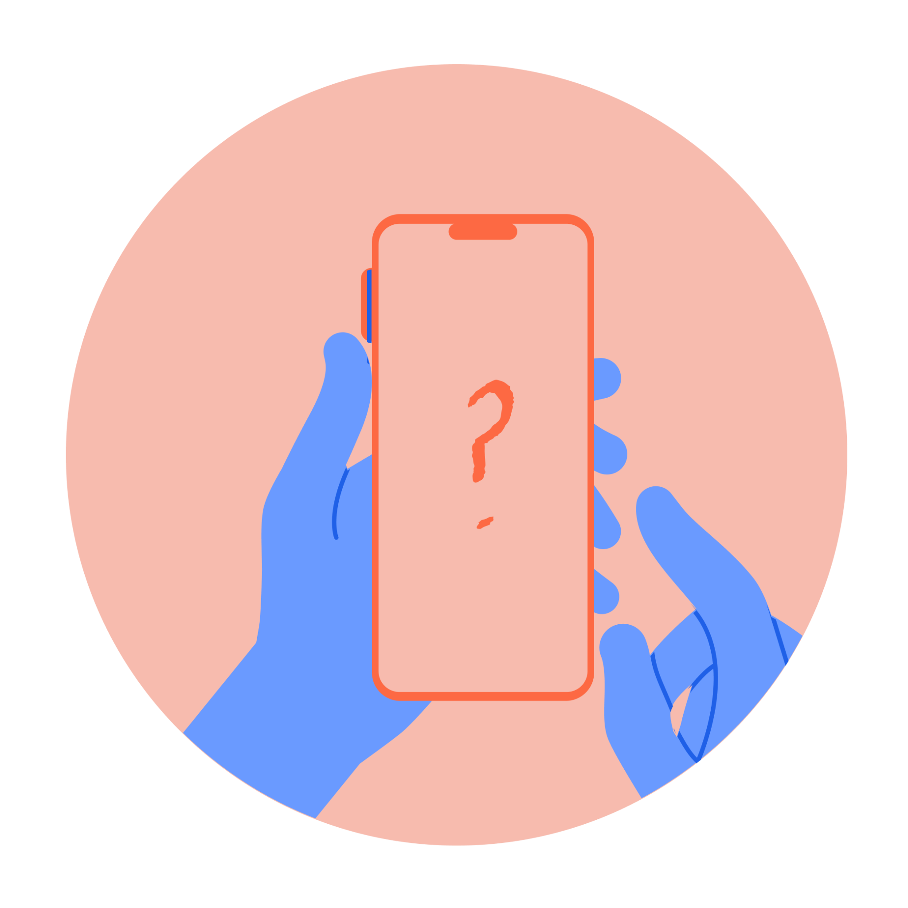
What is Tassomai?
Tassomai is an online multiple-choice quizzing tool that is powered by an adaptive algorithm. What this means is that Tassomai will:
Select the right content at the right time for you;
Unlock more challenging topics when you’re doing well;
Give more support to current weaker areas;
Provide a range of other helpful tools to help you learn!

Slide 8
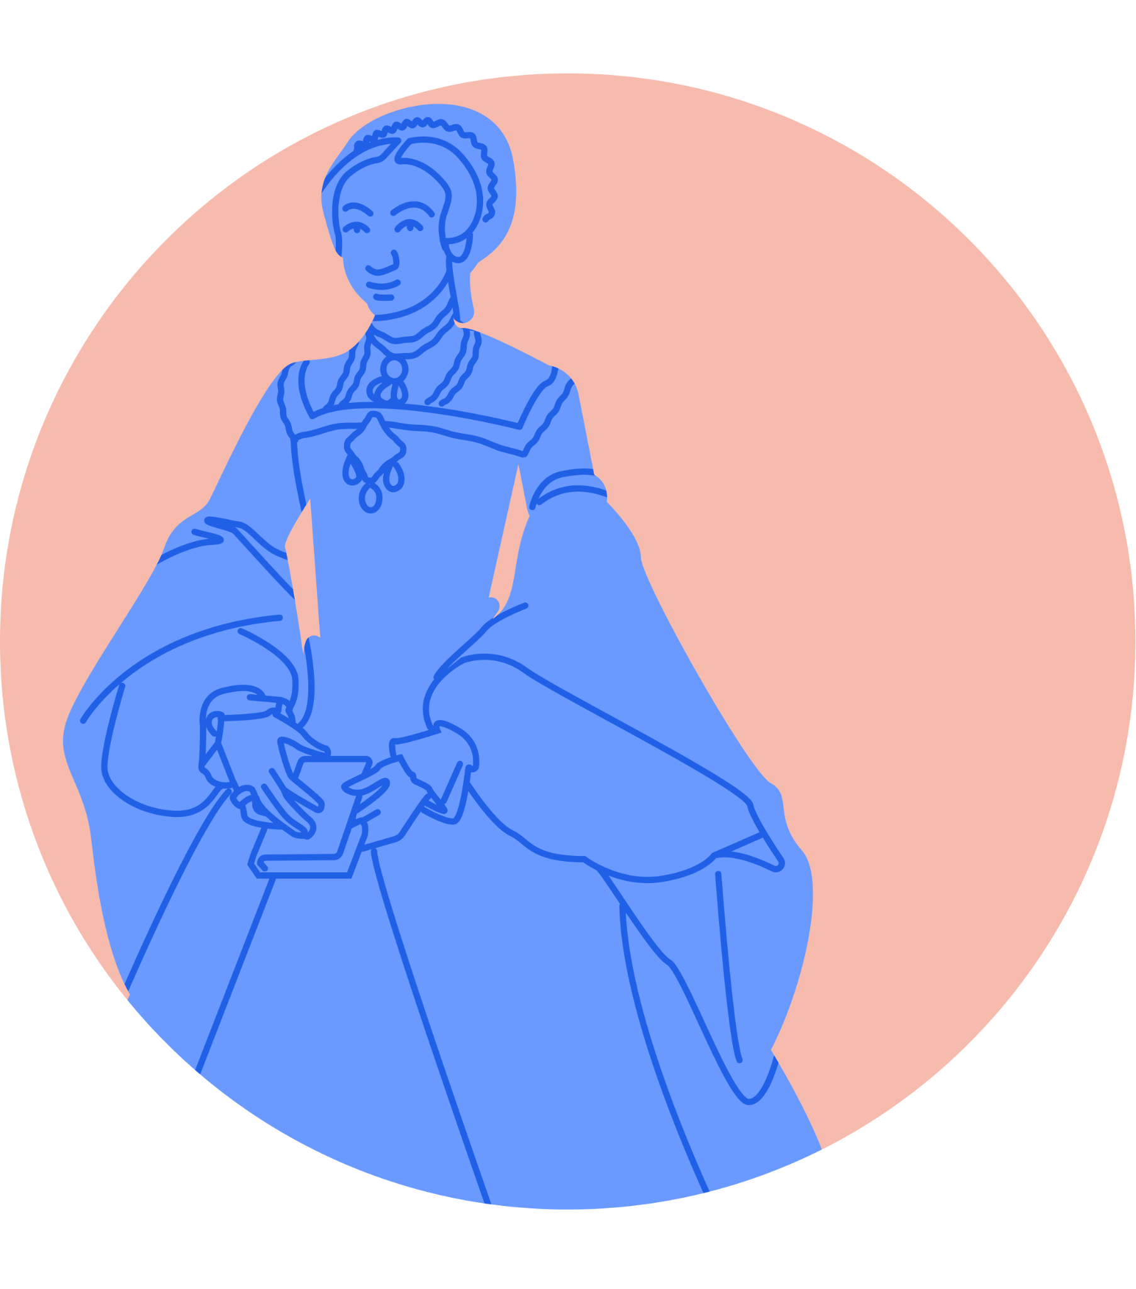
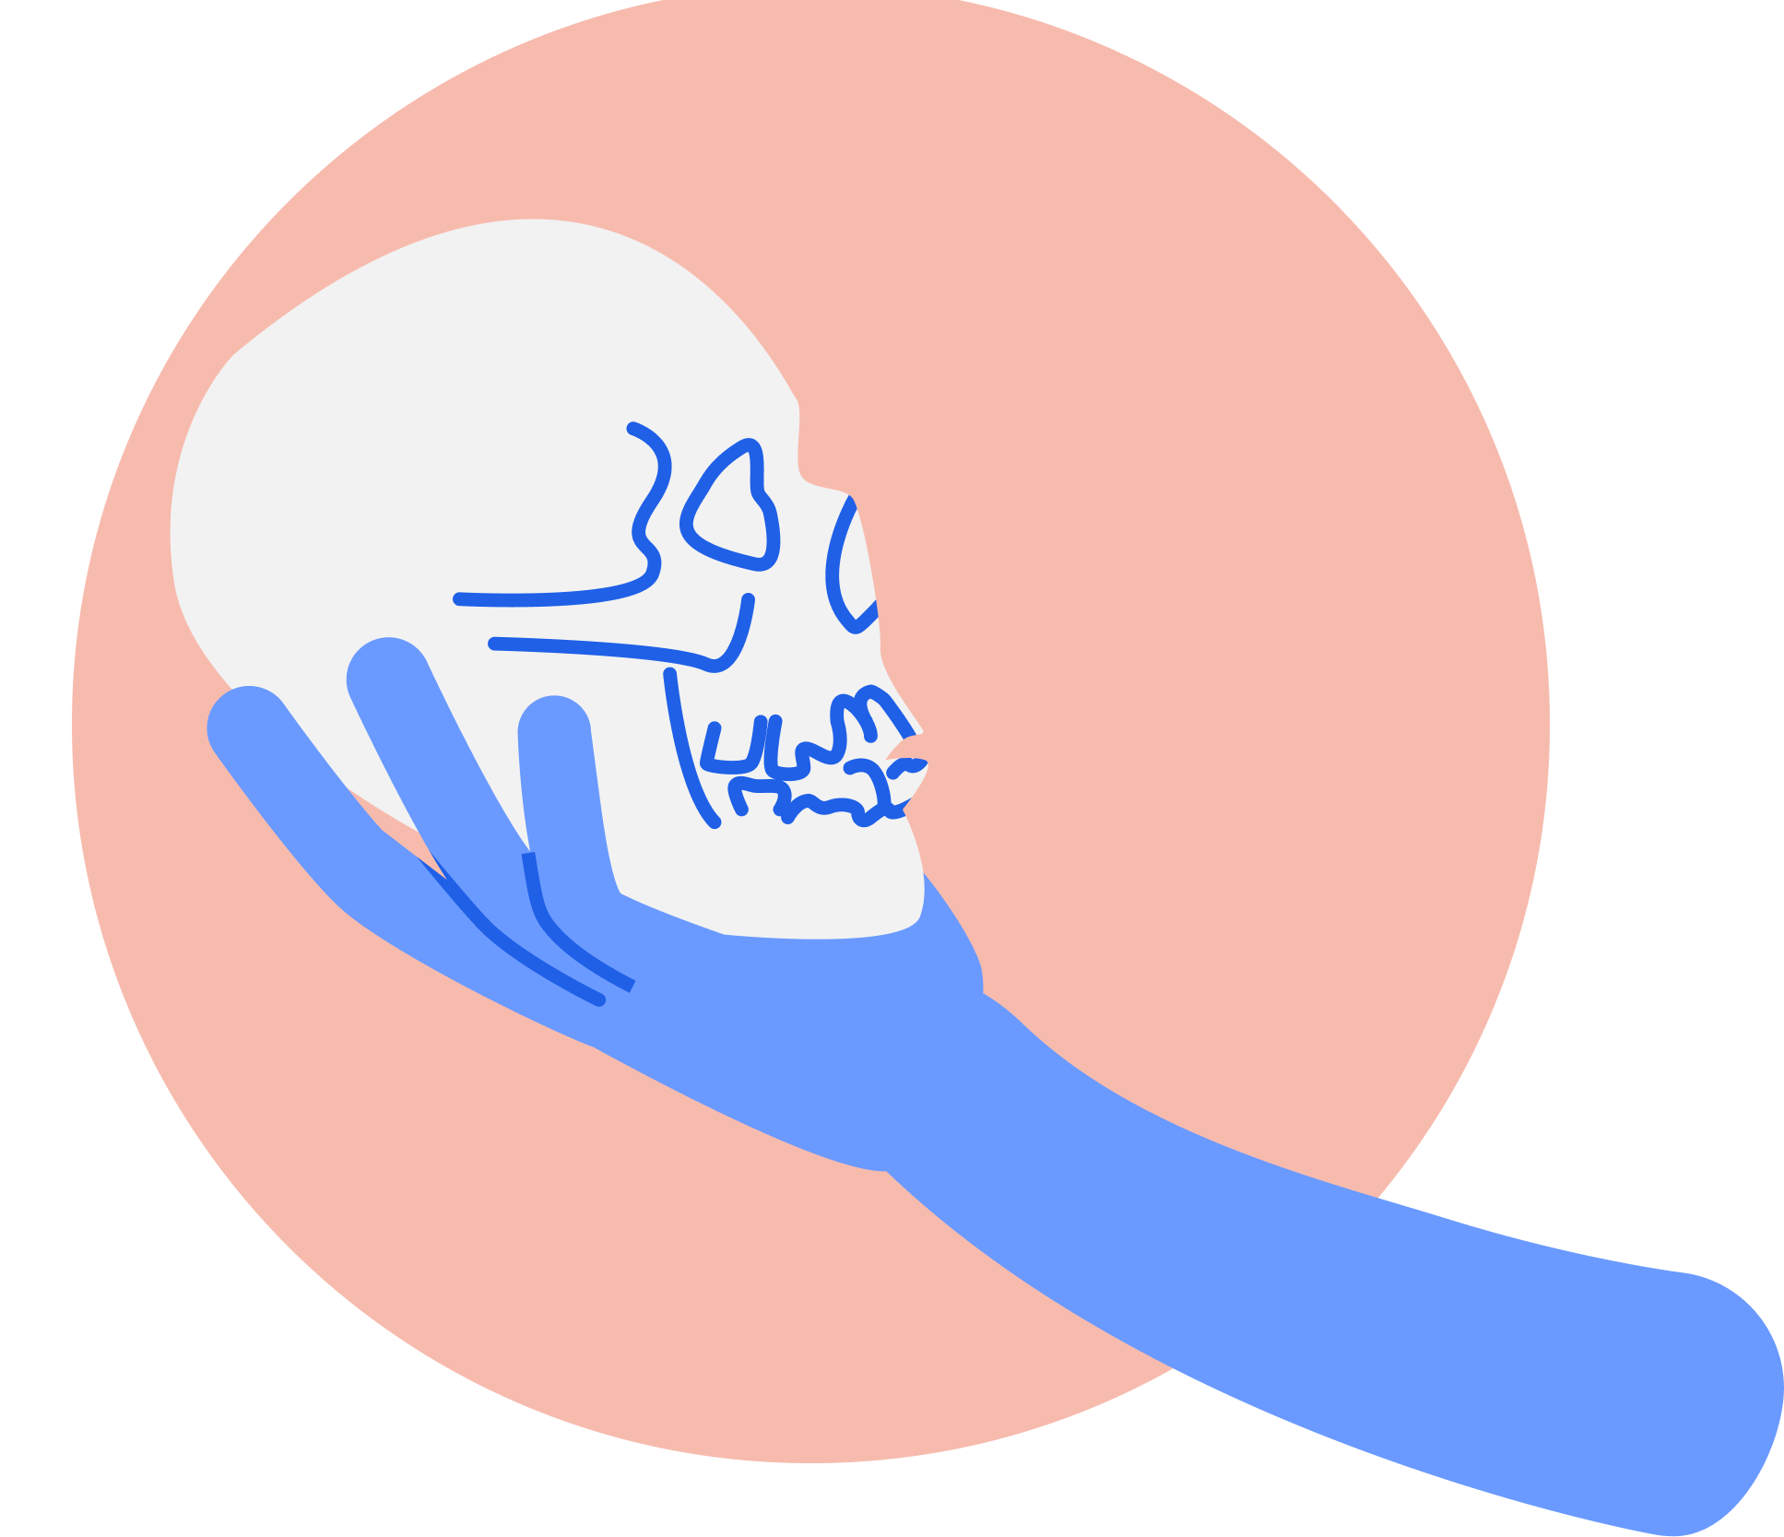
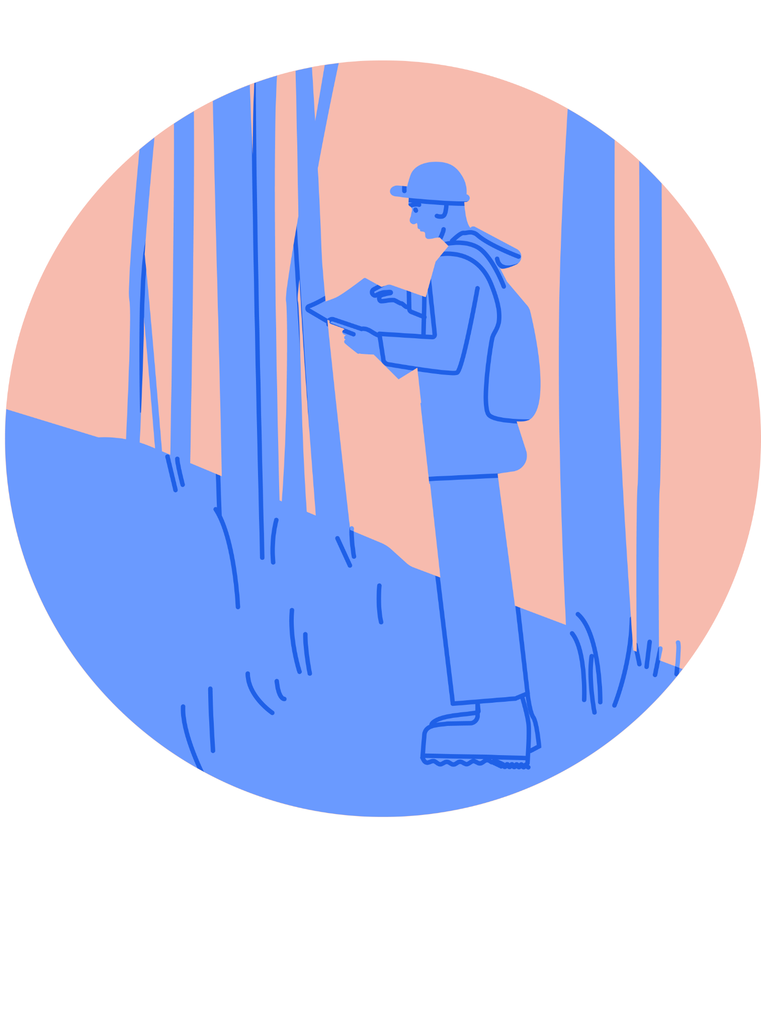
How does Tassomai work?
Each day, Tassomai will give you a set amount of work to complete. This is known as your Daily Goal (DG), and you will have a DG for every subject you have been assigned to.
Every correct answer in a quiz earns you 3 points towards your DG. If you hit the target score of a quiz, you receive 4 bonus points!
There are other ways to earn points…but you can lose points with incorrect answers, so answer carefully!
Quizzes do not have a time limit, so you can (and should!) take as long as you need to complete each one.
When you get enough points, you will complete your DG!

Slide 9
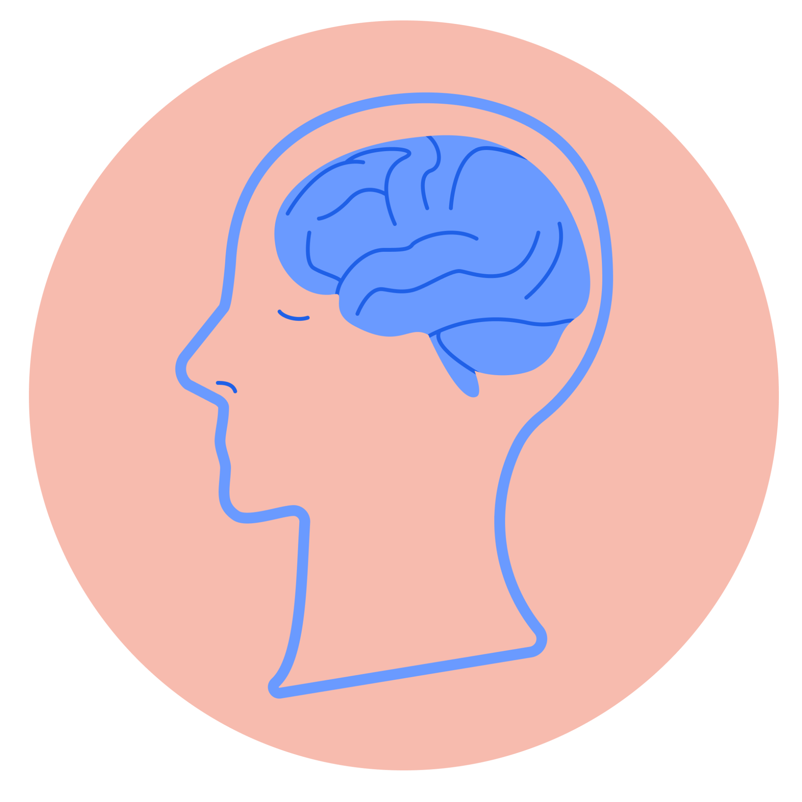
Why does Tassomai work?
Research into revision and learning techniques has found that the best way to study, and get knowledge to stick, is to:
Work for short, concentrated periods of time;
Frequently switch between topics;
Regularly test yourself.
Tassomai is designed to help you do all of these things!

Slide 10
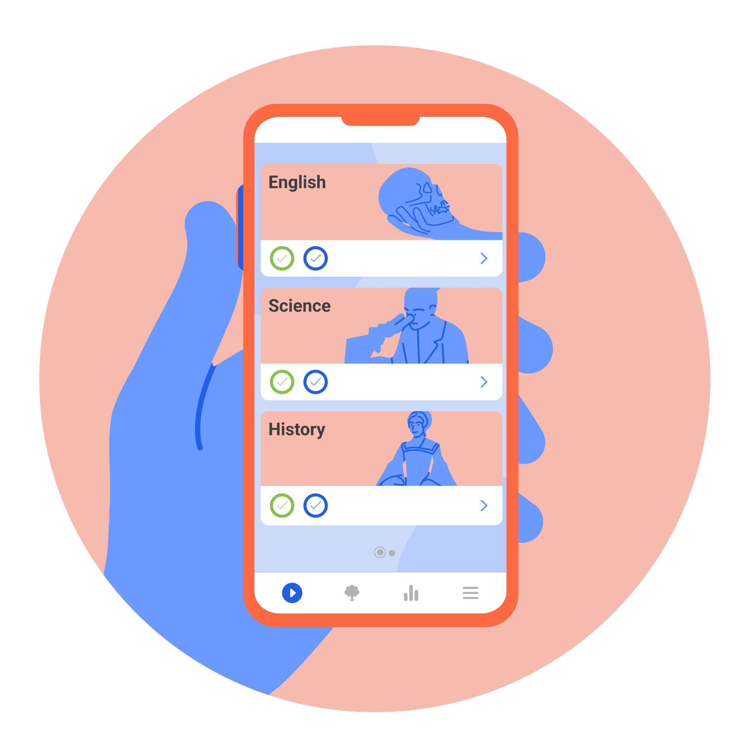
When & where can I work on Tassomai?
You can login to your account on a computer or laptop, or you can download our free mobile app and work using that instead!
No matter what device you use, you will need to be connected to the internet in order to take quizzes and access your data.
If you are halfway through a quiz and the internet drops out, don’t worry - Tassomai will store your completed answers until you’re reconnected!
Your Daily Goals can be completed throughout the day, so you don’t need to do all your work in one go. However, they will reset at midnight*, so be aware of that!
* 12am U.K time.

Slide 11
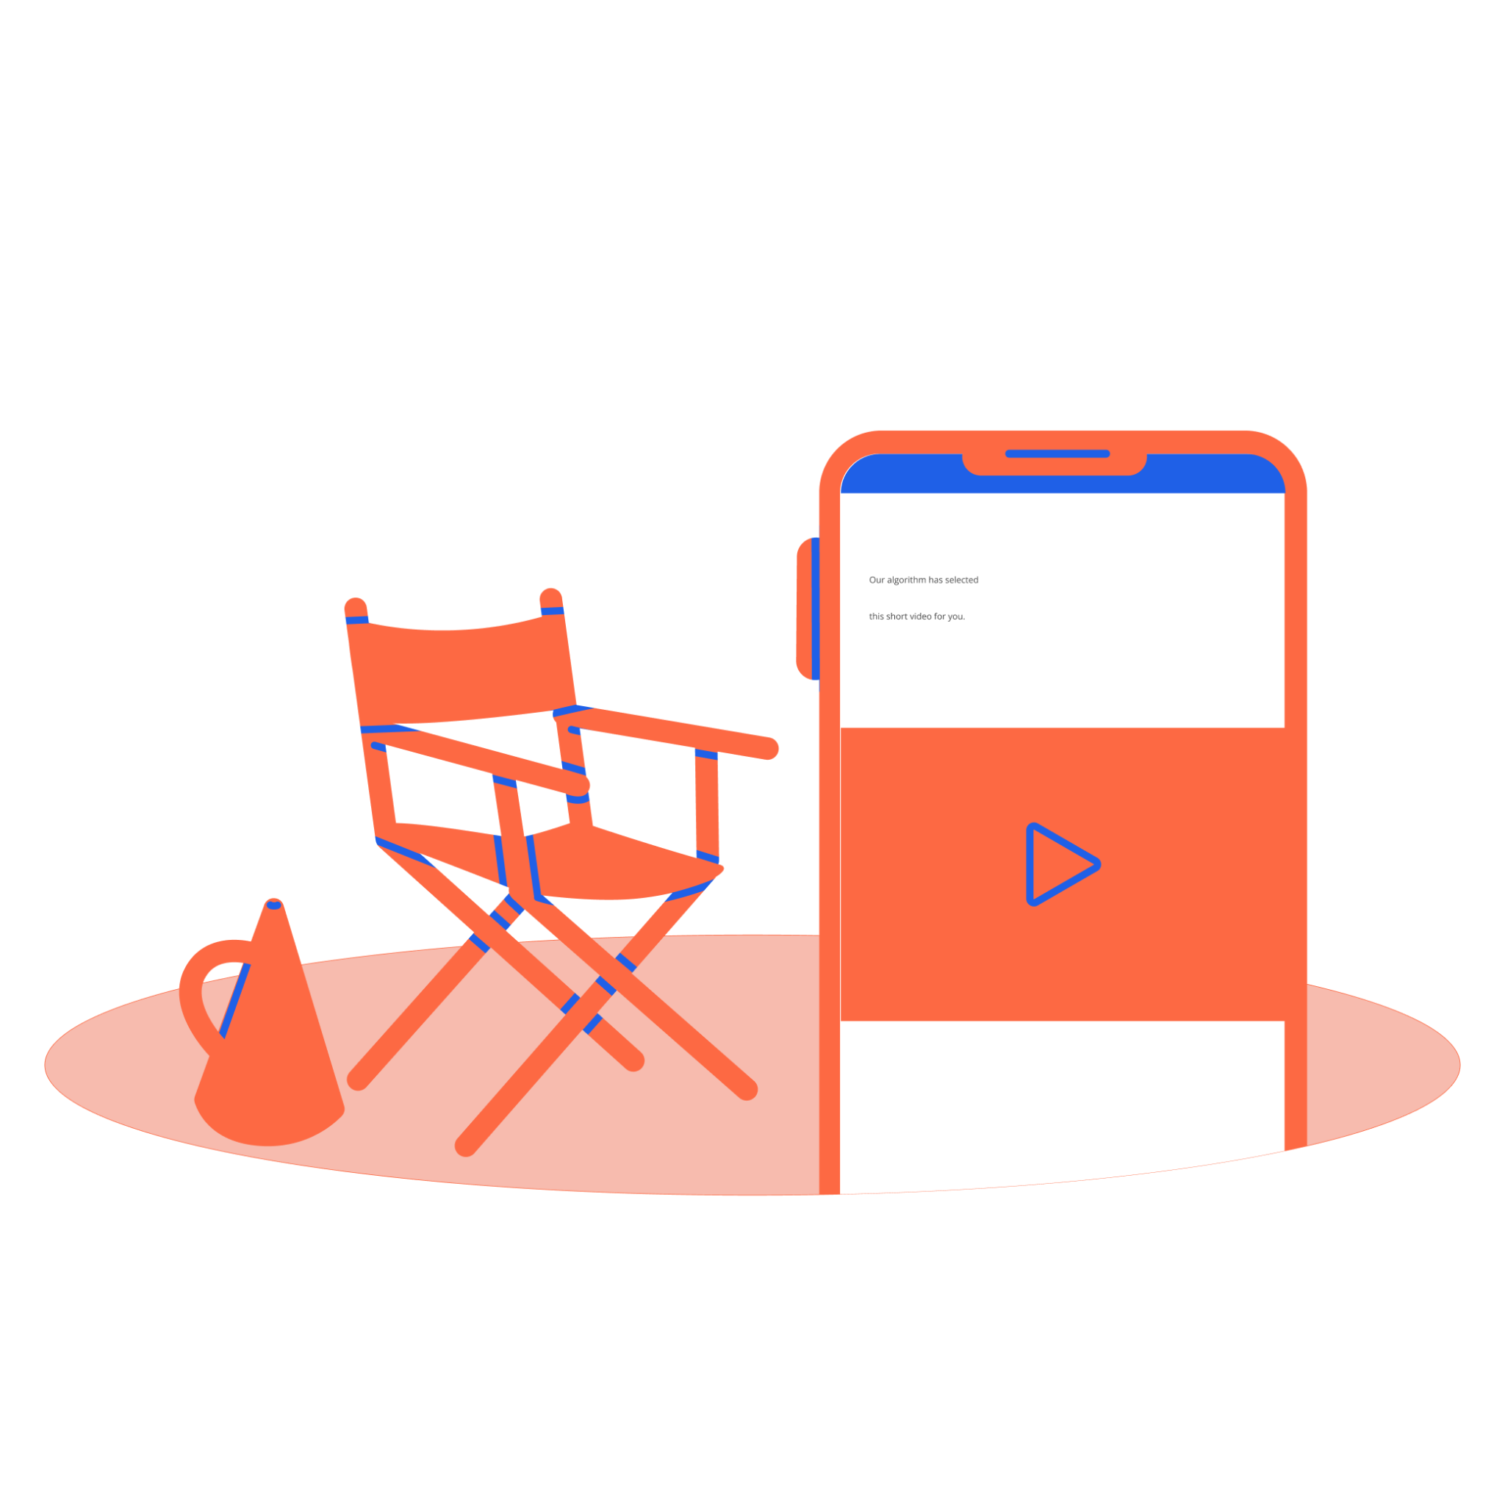
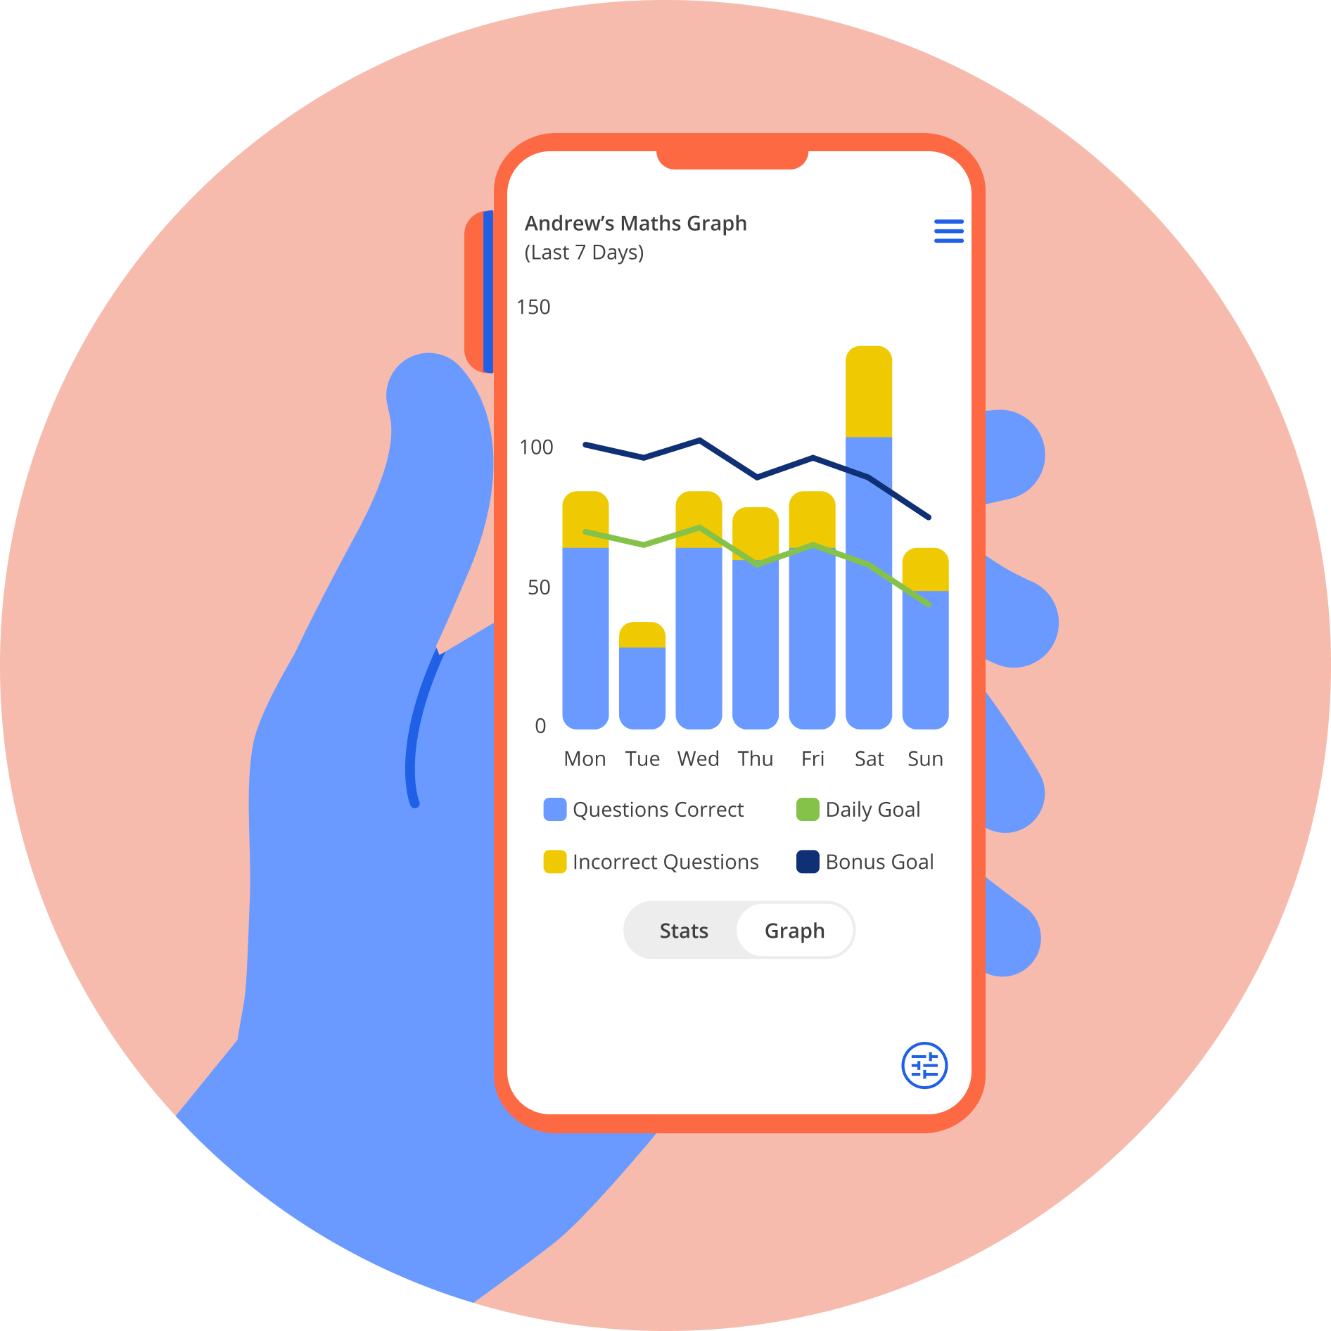
What else does Tassomai offer?
There’s loads more on Tassomai to help you master your learning and confidence!
Let’s explore some of these other tools…

Slide 12
The Tassomai Tree
You will have a tree for each subject you’re studying, and it will grow in size and colour as you work through the quizzes in that subject!
Branches on a tree are topics within that subject, and the leaves on branches are questions within that topic.
The larger a leaf, the more often you’ve seen that question while quizzing. If the leaf is a deep green, your accuracy has been high - but if it’s red, then you’ve had some difficulty in the past.
You can click on a leaf to read that question and see your data relating to it.

Slide 13
Your Data
Tapping on Usage will show you lots of information about your recent Tassomai use.
You can view different types of data and change the time frame. And, if you’re using Tassomai for more than one subject, you can separate your data between those subjects, or view them altogether!

Slide 14
Other Support
Tassomai has loads of other tools to help you improve your confidence when quizzing!
Your Review tab will show you your ten most recently taken quizzes, and you can reflect on any mistakes you may have made.
Once you’ve completed a Daily Goal in a subject, you can select Resources and be given 3 supportive materials on areas you struggled with. You’ll either get an online article, or a video to watch.
Speaking of videos…if you’ve had difficulty with a particular topic in the past, you might sometimes be offered a short video to watch before you next take a quiz in that topic. Watching those videos in full has a useful bonus…but you’ll need to discover this for yourself!

Slide 15
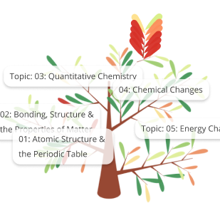
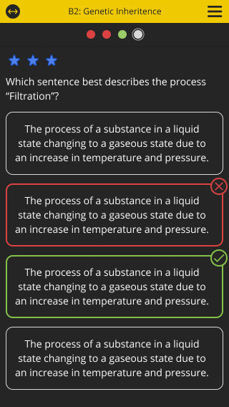
What’s new for this school year?
Tassomai’s got plenty of new tools to help you even more this year - let’s take a look at some of them:
Tree Labels - your Tassomai Trees now have helpful labels to help you quickly pinpoint particular topic headings.
Dark Mode - we’ve listened to students’ feedback, and the app now has the option to switch to dark mode, so you can get your Daily Goals done comfortably at a time that suits you.
Text to Speech - if you want to have Tassomai’s questions & responses read aloud before answering, simply go to your Settings and turn this new system on! Note that some questions cannot currently be read aloud, but we’re hard at work to add these too.
MAI: Tassomai’s AI system - we’re excited to start using the power of AI to provide you with direct help in your quizzes. Once per quiz, you can ask MAI for support in answering the question. It won’t give you the answer, but will work with you to help select the correct response.

Slide 16
I’m new - how do I get started?
Good news - your account is ready to go!
You can login to your account (either from the mobile app or Tassomai’s website) using your school email address and the default password QuizLearnGoal.
The first thing you will be asked to do is change that password to something more personal.
Next, you will be given a list of classes, separated by year group and subject. Select all of the classes you belong to (have your timetable handy in case you’re not sure!) and then press Submit.
You’ll then be able to take your first quiz!

Slide 17
I’m returning to Tassomai - what do I do?
Your password to your account will not have changed, so simply use the email address and password from last year. You will then be asked to select your new class(es) from the drop down menu that will appear. Have your new timetable with you in case you’re not sure of your new classes yet!
If you cannot remember your email or password, ask one of your teachers to help - they can reset your password, and remind you of your email, using their teacher account.

Slide 18
How is it going to work?
At first, you will be using Tassomai for English work, then you'll start using it on the other subjects Science, History and Geography.
Once we have your log ins, you will have a chance to log into the computers at school to have a look at how this will work for you.

Slide 19
How do I log in?
Visit the Launchpad, and click on the Tassomai link.
Login: School Email
Password: QuizLearnGoal
(password will be case sensitive)
Please write this information down!
THEN – Change your password to something personal, but DO NOT SHARE this password.

Slide 20
Home Learning and Study Hall
When setting homework or revision your teachers must make clear it links to the learning. It is important that you understanding why/how the task is vital if you are going to be successful and complete the work.
It takes time to build good study habits via homework and revision and it is our job to support you to develop these skills, as we do through our study skills sessions during form time.
When setting homework/revision, teacher will:
Expect you to clearly recorded homework or revision in your planner with clear deadline.
They should check you have done this, at the end of the lesson or at the door at the end of the lesson and make sure you have any resources required.
It is their role to make sure:
You are clear about the homework or revision;
That you understand it and it is something you can do without teacher support;
Make sure it is relevant to an upcoming lesson:
Either revision of previous important knowledge (from the knowledge organiser);
Or revision of concept to be tested in a Do Now.

Slide 21
Home Learning and Study Hall
Q. What happen if I do my homework or revision?
If you complete your homework and revision you will be given reward points and your AtL judgement for home learning will increase moving you up the ranking and leading to further rewards and praise.
Q. What happen if I do not do my homework or revision?
Stage 1. Your teacher will ask the reason for non-completion, offer support and - set an extended deadline. They will also remind you to take responsibility and use the study hall in the afternoon for support.
Stage 2. If you still do not complete the home homework or revision, your teacher will book you into study hall (via Go4Schools – you will also receive a negative point) to work with the Raising Achievements mentors to complete it.
Stage 3. If you do not take responsibility and fail to attend study hall:
You teacher will call your parents and raise the issue with the Head of Department to decide what further support is required.
If you frequently do not complete your homework or revision, you will be placed on subject report to Head of Department and your parents will be invited to the academy for a meeting with your teacher and the Head of the Department.
Stage 4. After the report is complete, if you are still failing to complete homework or revision, your HoY will then be involved and place you on a report

Slide 22
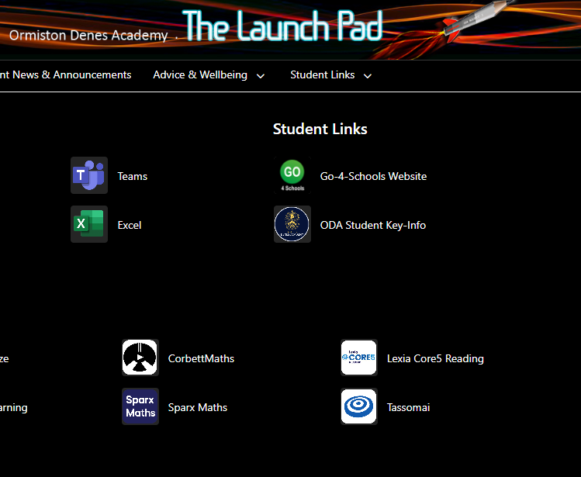
Home Learning and Study Hall
Q. Where is study hall and how does it work?
KS4 Study Hall is in the Entrance Hall and will be run by Mrs Gaines
KS3 Study Hall is in the New Hall and will be run by Mrs Howes.
They have laptops for students who need support for the Maths homework/revision (Sparx) and English, Science, Geography and History Online revision (Tassomai).

Slide 23
Coming soon...
Core PE intervention programme (some students won’t be doing PE until PSAs are completed EN/MA grades 4+)
Some students will soon be coming out of PE lessons so that they can catch up with BTEC Coursework – e.g. Sport & Health and Social Care.
If you're one of these students, you will always report to PE first to get your mark, before being taken to the catch up session that you are expected at.
Notes:
School offers loads of support – link to attendance/results

Slide 24
BTEC PSAs
September 2023
Autumn Term​
Raising Achievement Evening​
BTEC PSAs​
Mock Exams (November)​
Information about next steps (College Application)
These assessments are set assignments from the exam board.
This means they will be treated like an exam. You must attend them, and expect us to call or request medical evidence if you are absent.
Christmas
Spring Term​
Year 11 Parents' Evening ​
BTEC PSAs​
Mock Exams (March)​
College Application completion
Easter
FINAL EXAMS

Slide 25
Raising Achievement Evening
Raising Achievement Evening tonight at 6pm
Remember that this will contribute towards prom points
If your parents/carers cannot come, then please come on y our own
Come and hear about:
Revision tips
Support available to you
Tassomai and Sparx
Speak to different colleges
Key Dates

Slide 26
Don't forget...
Prom is not a guarantee. You will get your place by working hard and proving you can do it.
Attendance to the Raising Achievement evening will contribute towards prom points
Home Learning is for your benefit! Evidence suggests that regular and high quality home learning will lead to students making progress
It is really important to look after yourselves

