Slide 1

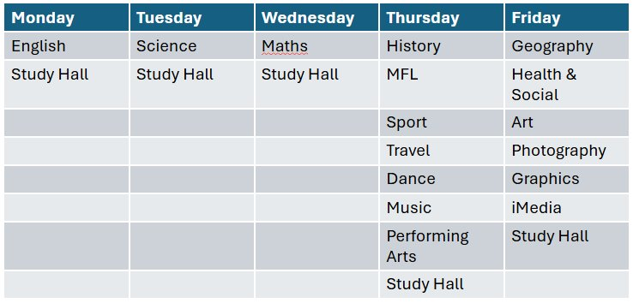
Year 11 Period 6 Timetable

